Slide 1
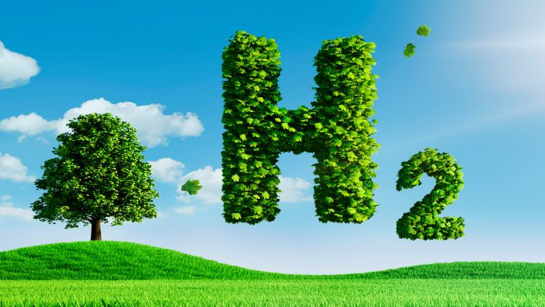

Slide 2
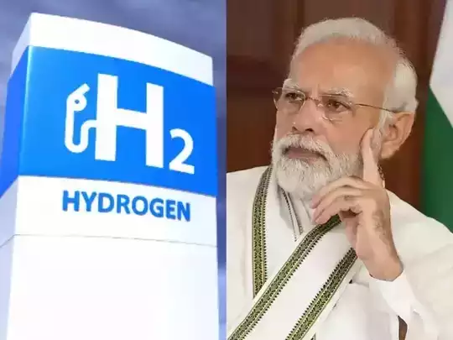
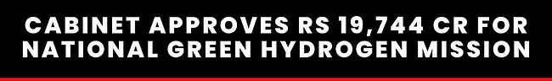
Budget 2023: Govt targets 5 MT of Green Hydrogen production by 2030

Slide 3
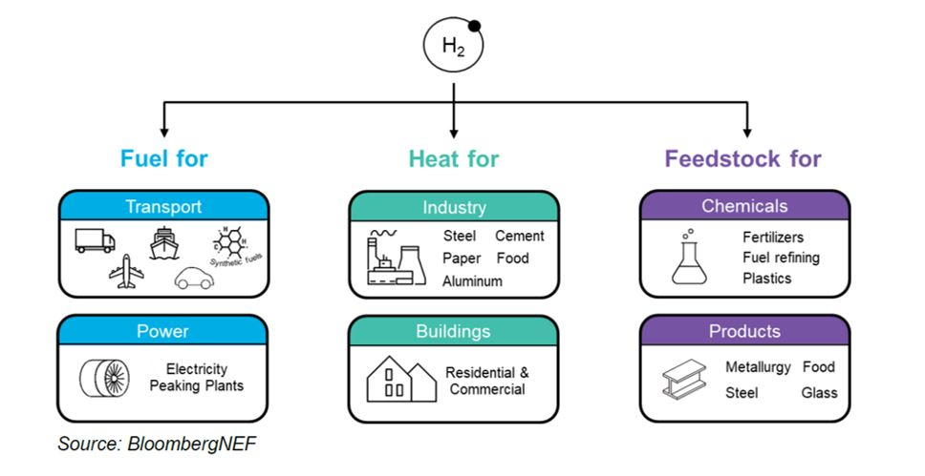
Applications of hydrogen
https://blogs.worldbank.org/ppps/green-hydrogen-key-investment-energy-transition

Slide 4
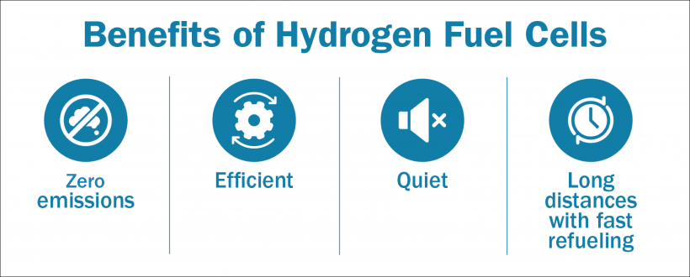

Slide 5
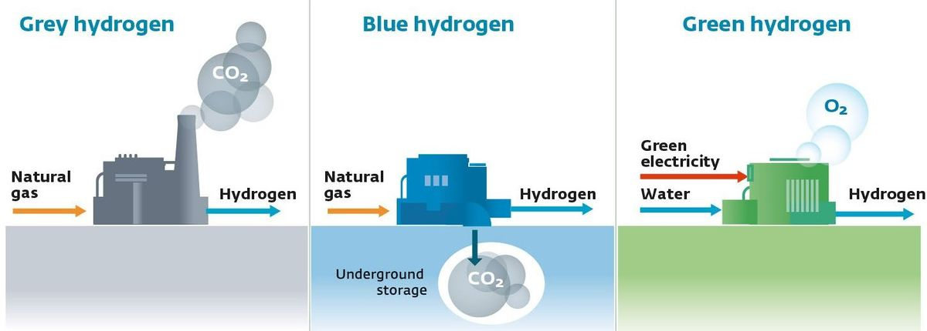
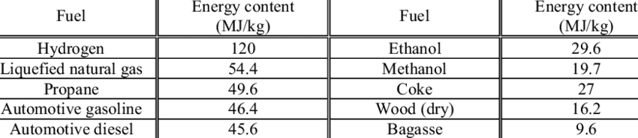
Types of hydrogen

Slide 6
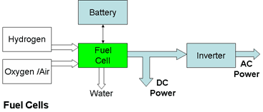
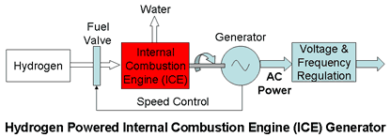
Hydrogen to Electrical energy to mechanical energy

Slide 7
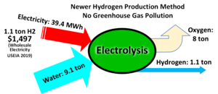

Slide 8
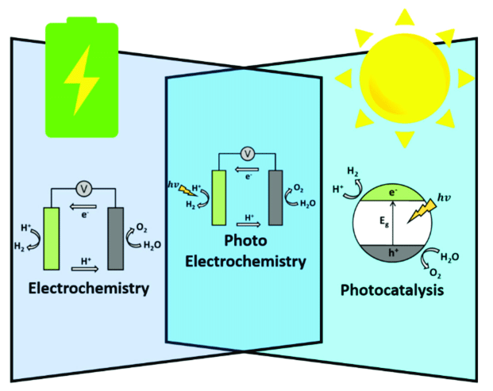
Electro catalysis and Photoelectrocatalysis

Slide 9
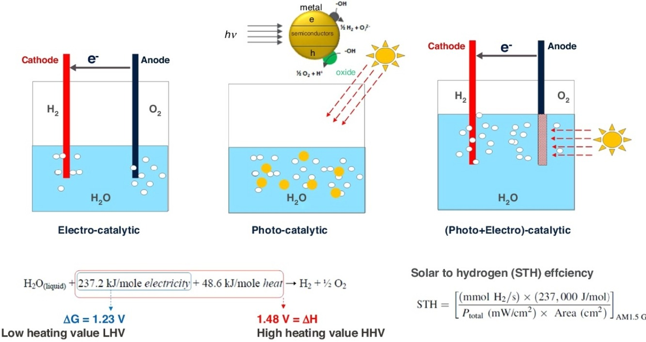
Electro catalysis, Photocatalysis Photoelectrocatalysis
https://doi.org/10.1016/j.coche.2020.05.009

Slide 10
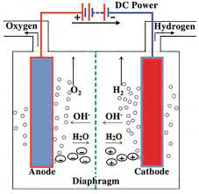
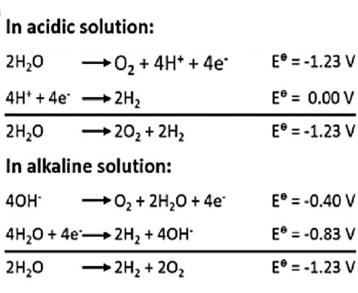
Hydrogen generation: Electrocatalysis Mechanism of HER and OER reactions

Slide 11
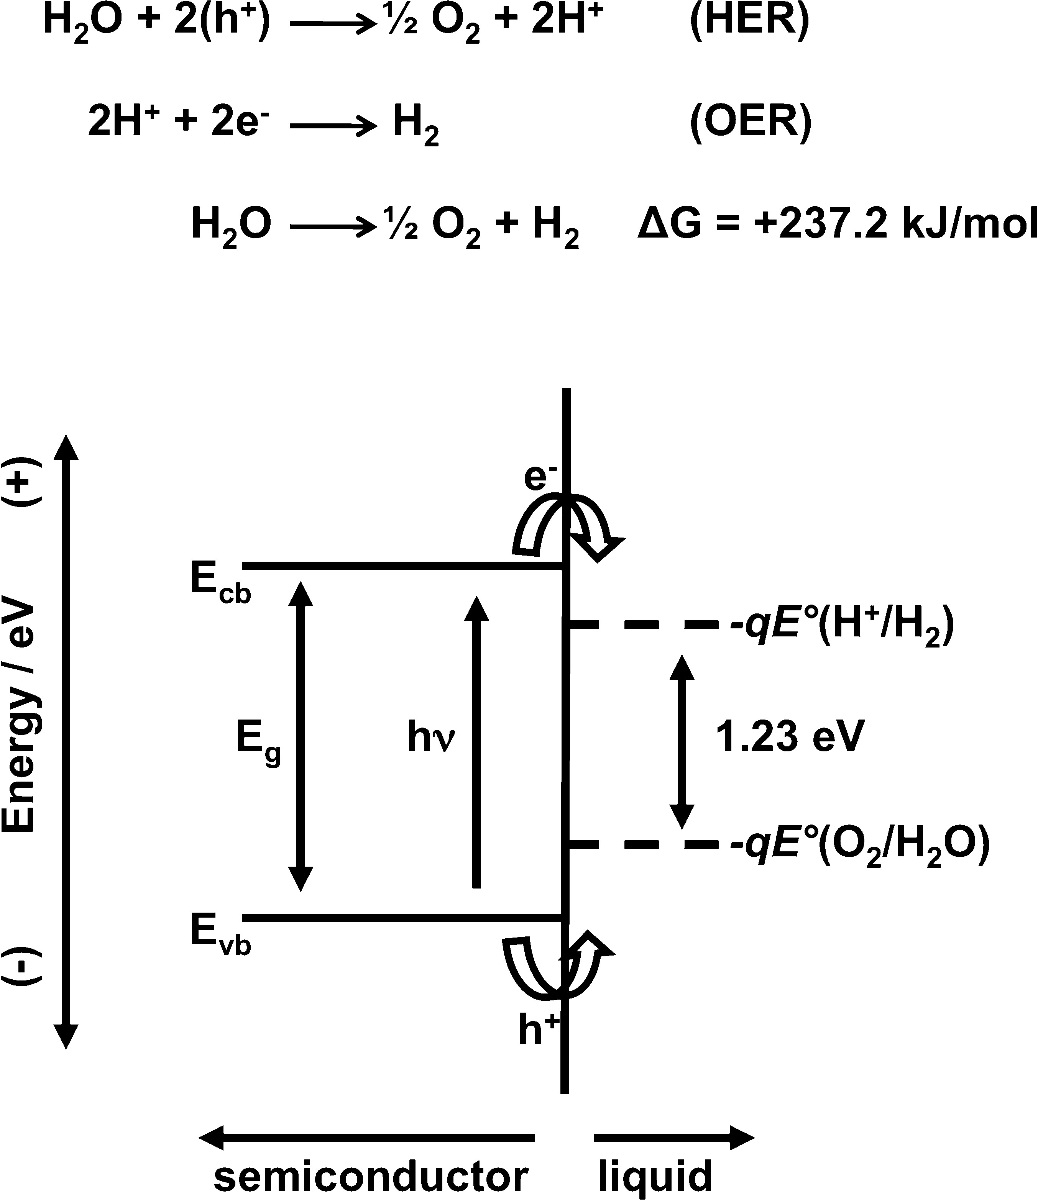
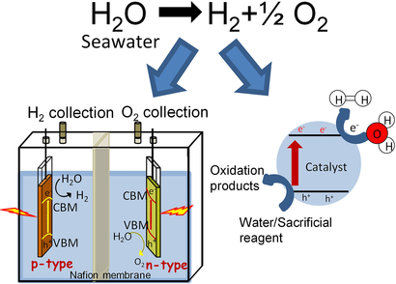
Photocatalysis

Slide 12
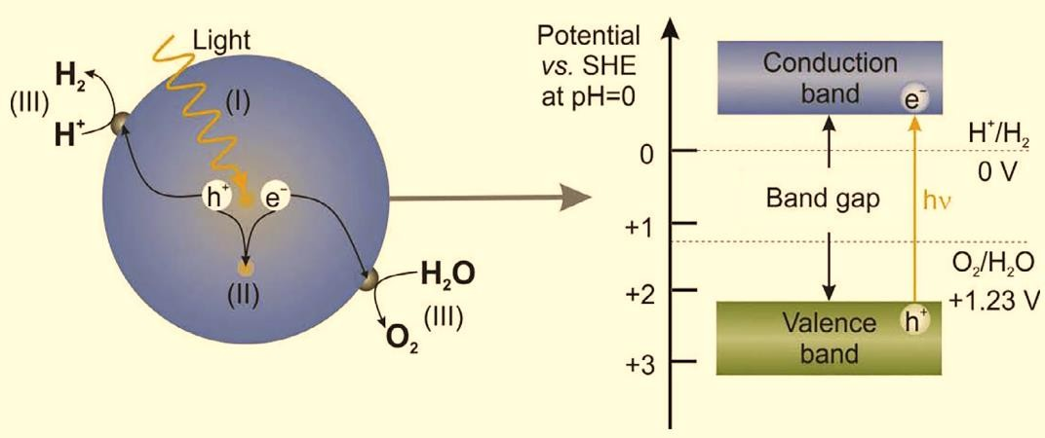
Photocatalytic water splitting systems
Water splitting, is the splitting of the water into its constituent elements: hydrogen and oxygen. The energy required to cleave H-O-H bonds can be supplied by different power sources: electrical (current), thermal (heat), or light (electromagnetic radiation). For photo catalyzed water splitting to occur, the bandgap should be more the 1.23 eV, which is the difference between the reduction potential of H2 and the oxidation potential of O2

Slide 13
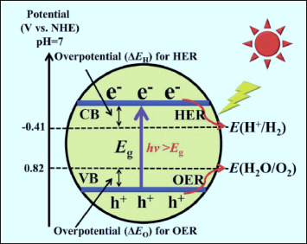
Bandgap of catalyst suitable for HER (Hydrogen Evolution Reaction)and OER (Oxygen Evolution Reaction) reactions

Slide 14
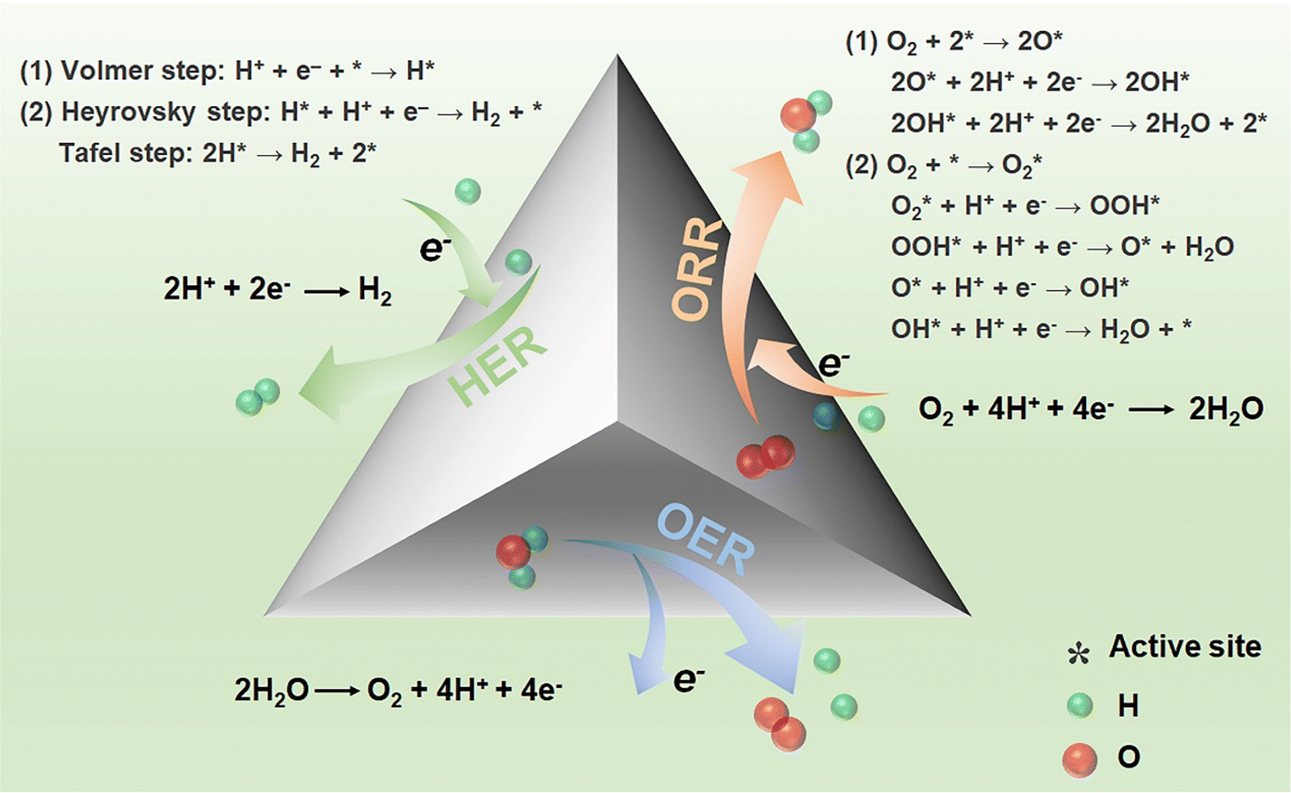

Slide 15
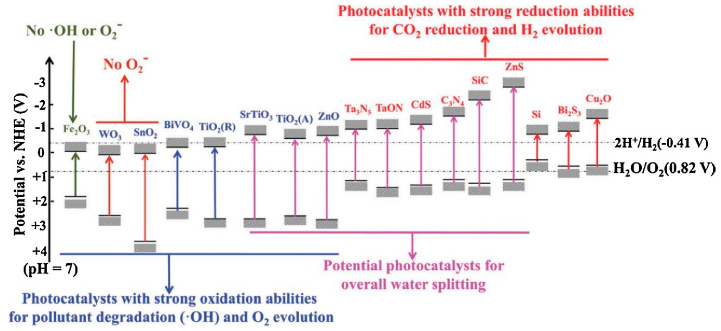

Slide 16
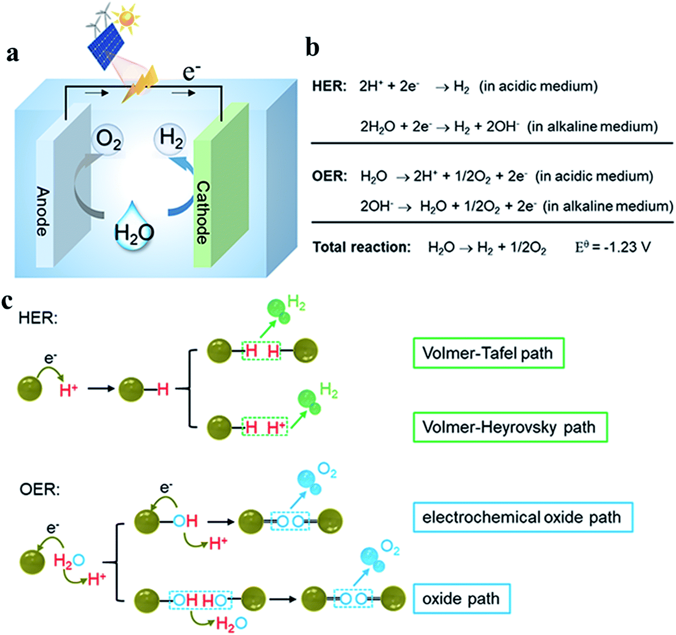

Slide 17
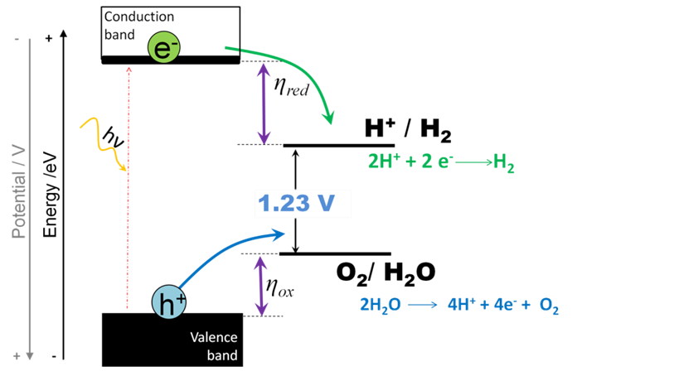
Over potential (η): Additional potential required than thermodynamically determined potential in order to drive a redox reaction.

Slide 18
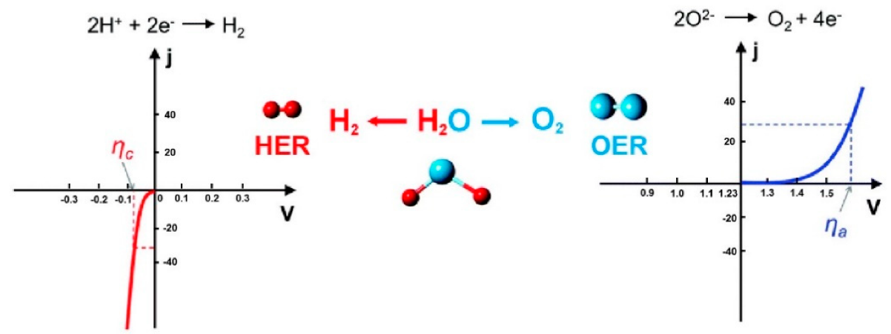

Slide 19
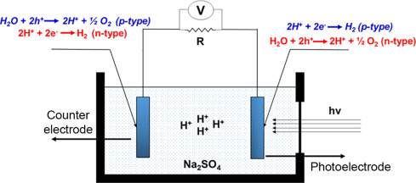
Photo-electro-catalysis
https://doi.org/10.1016/B978-0-12-814853-2.00012-6

Slide 20
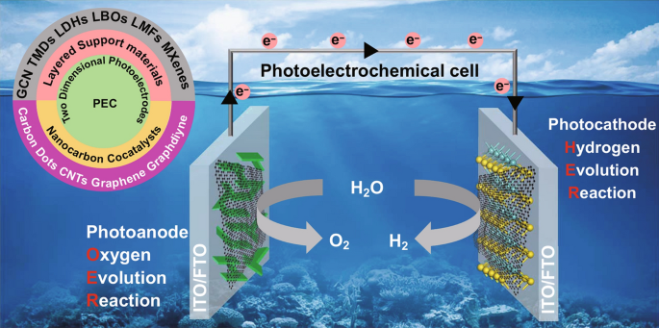
Photo-electro-catalysis

